Slide 1
Components

Slide 2
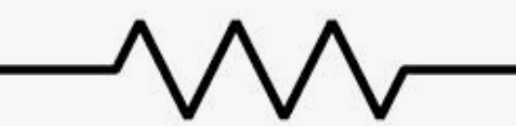
Resistor

Slide 3
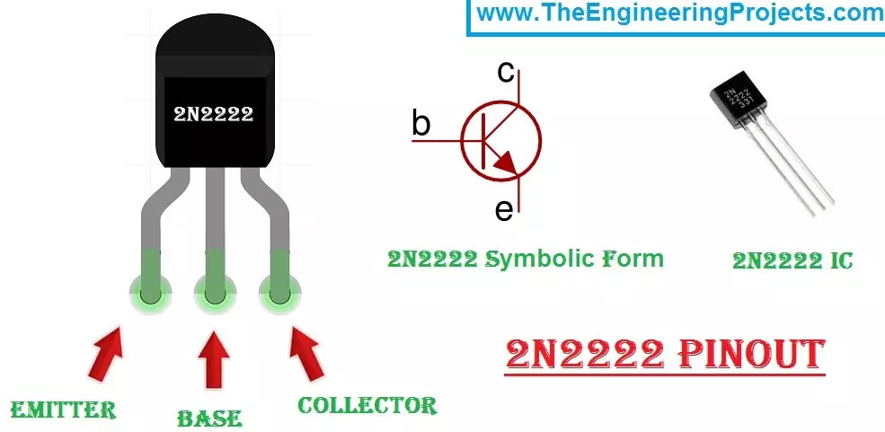
C
2N2222
B
E
C
E
B

